Slide 1
Multiclass Classification
Codes are in Python 3

Slide 2
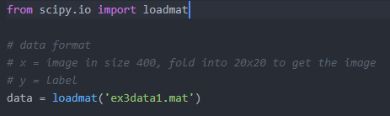
Load dataset
Provided in the format of .mat
Can be loaded using external lib

Slide 3

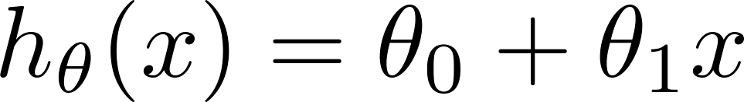
Load dataset
Load the labels
Load the training data

Slide 4
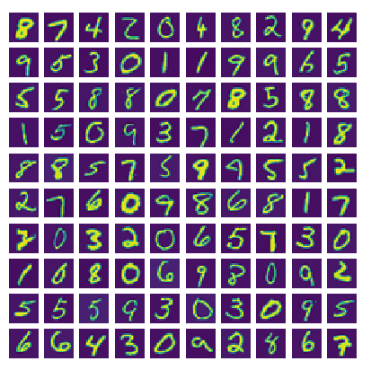
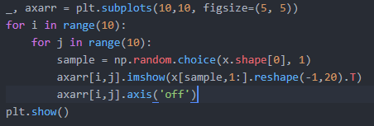
Dataset
Show images from dataset
Subset of the MNIST dataset
Note: 0 is labelled as 10

Slide 5
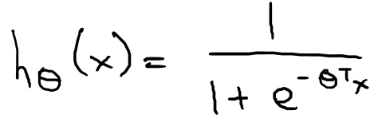

Sigmoid function (Logistic function)

Slide 6
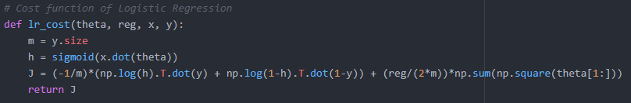
Cost function
Regularized
Vectorized

Slide 7
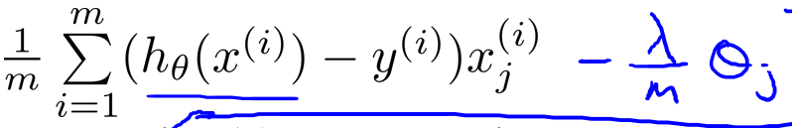

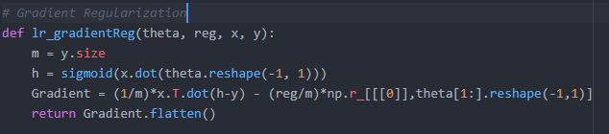
Gradient
Regularized
Vectorized

Slide 8
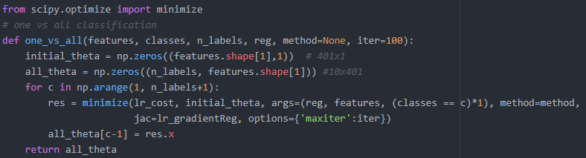
Optimization
Use external library to handle the optimization
The result is 10 model for each different class, store in all_theta

Slide 9

Prediction
Feed in the model and data
Do a dot product on the matrices to get result
Return the max probability of the 10 model
Result is + 1 because Python counts from 0

Slide 10
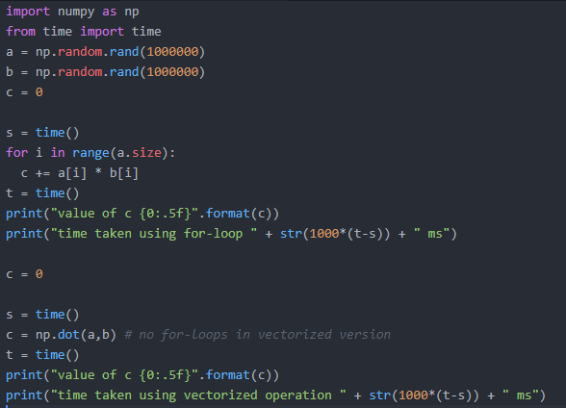

Extra
Purpose of vectorizing

Slide 11

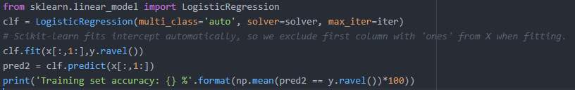
Extra
Can use scikit-learn existing model

Slide 12
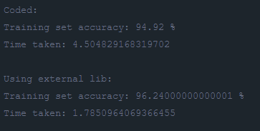
Result

Slide 13
Question 2: Implement feedforward propagation algorithm for learning the neural network parameter
Answer are in python code (as converted from example octave codes provided in Andrew Ng’s course assignment)

Slide 14
Model Representation
L1 - 400, L2 - 25, L3 - 10
400 input layer units (20 x 20 image)
Theta1 and 2 are trained
Theta1: 25 x 401
Theta2: 10 x 26

Slide 15
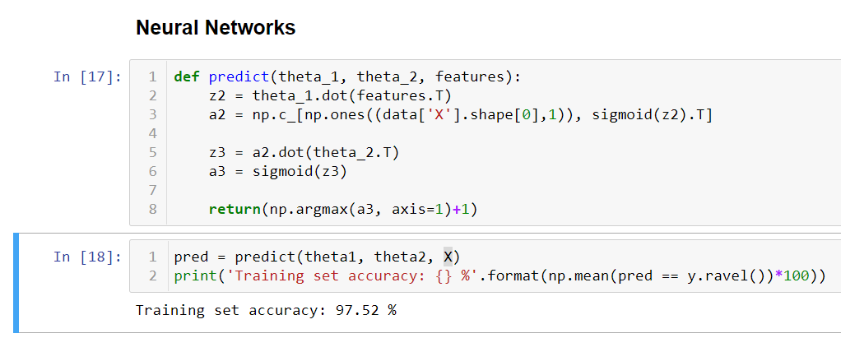
Feedforward Propagation of Prediction
Compute h(X) of each example
Compare to label, 1 = correct, 0 = wrong
Accuracy = mean of prediction

